Slide 1
CRIME ANALYSIS
For cities : LA & New York
Karishma, Shikha, Thom

Slide 2
The Data
We relied on raw data for two major US cities from https://catalog.data.gov/dataset/
Specific datasets used are available for evaluation here (note: some data may have changed since data was pulled for this project.)
New York: https://catalog.data.gov/dataset/nypd-complaint-data-historic
LA: https://catalog.data.gov/dataset/crime-data-from-2010-to-present

Slide 3
Objectives
Gain a better understanding of trends in crime overall, as well as specific crime types.
Attempt to find any distinct correlation between the type of crime with factors like time of the day, season, area, location of crime (inside, outside, specific business) etc.
To come up with a model which would help to predict future crimes to some extent.

Slide 4
Limitations of the Data
For privacy and security reasons, the specific address at which a crime occurred is not provided, which makes it more difficult to determine area-specific trends
The data available varies city to city, year to year – there is more data available for more recent years, which makes it harder to chart or predict meaningful trends over a longer period of time
Some reports include information on the victims (gender, race, etc.) but there is not enough consistently available info to draw meaningful conclusions about which population are at the greatest risk based on the dataset used

Slide 5
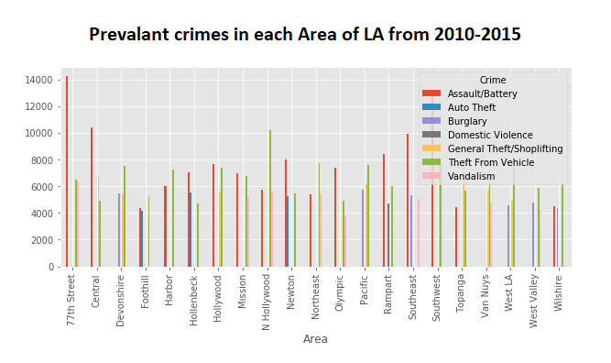
Los Angeles Crime: Totals by Area
When evaluating the most prevalent crimes in each area of Los Angeles, we found that while there are some hotbeds for specific crimes, such as more violent crime in the 77th Street area, nowhere is entirely immune to crime. Assault, general theft, vandalism, and domestic violence are the most common crimes across Los Angeles.

Slide 6
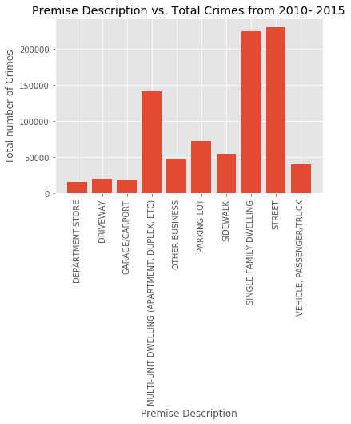
Los Angeles: Premise vs. Crime
More crimes occurred outside in the street than any other single location type, though overall crimes were more likely to occur inside residences if we combine all residence types

Slide 7
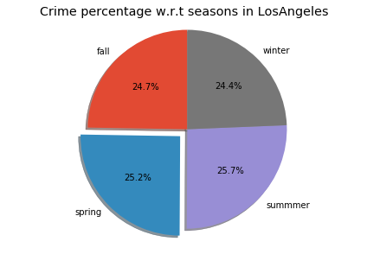
Los Angeles Crime: By Season
While we thought there might be a difference in the amount of crime from season to season, in LA, the crime is even more consistent than the weather

Slide 8
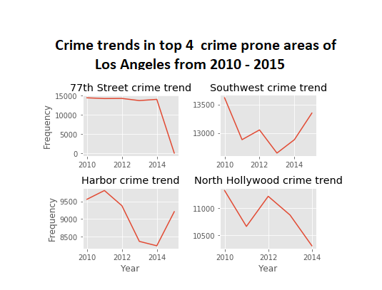
Los Angeles Crime: Trends by Area
When evaluating some of the areas in LA with the most crime, trends showed a lot of variation year to year. It may be worth drilling into what new practices have been put into place in the 77th Street and North Hollywood areas that could benefit crime reduction in the Harbor and Southwest Areas.

Slide 9
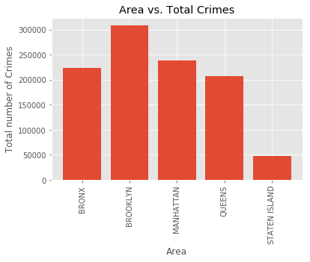
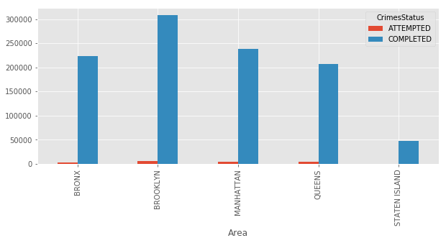
New York Crime: Totals by Area
When evaluating crime in New York at a high level in New York, the numbers are fairly predictable. Total crimes are roughly correlated to the population of each borough – Brooklyn is not necessarily more dangerous, just more populous.

Slide 10
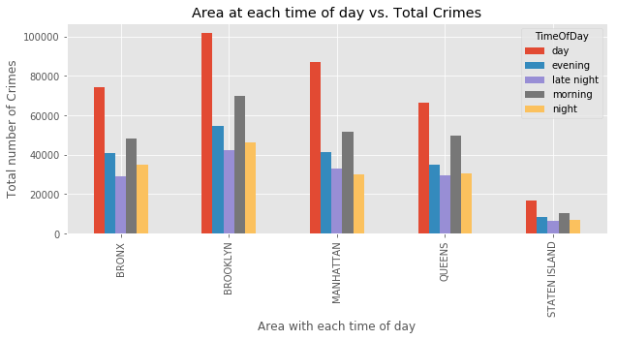
New York Crime: By Time of Day
When evaluating crime against the time of day committed, we again did not see a major difference from borough to borough, though we were able to see some trends:
More crime occurs during the daytime across all boroughs
Crime is least likely to occur late at night, potentially due to less potential victims being out and about, even in the city that never sleeps

Slide 11
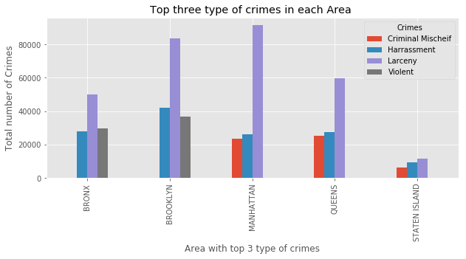
New York Crime: Common Crimes
We did see differences in the types of crime most likely to occur in each borough:
Larceny (theft) is common across all boroughs, as is harassment
Violent crime is more likely to occur in larger numbers in The Bronx and Brooklyn
Criminal mischief (vandalism) is more likely to occur in Manhattan, Queens, and Staten Island

Slide 12
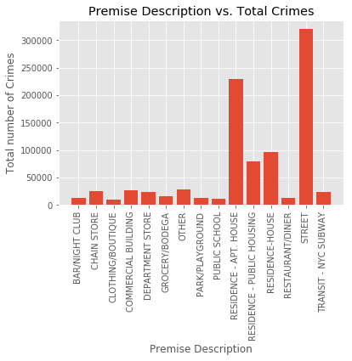
New York Crime: Premise vs. Crime
Just like in the Los Angeles Data, the single highest total occurred outside on the street, but if we add all the housing types listed we see that it’s more likely that crime happens in a private home than any other area.

Slide 13
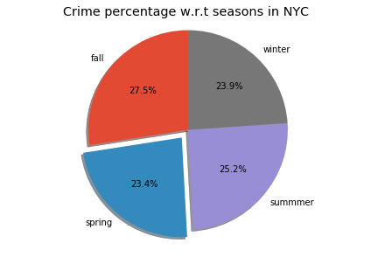
New York Crime: By Season
Crime is relatively consistent year-round, though there is a small uptick in crime in the Summer and Fall.

Slide 14
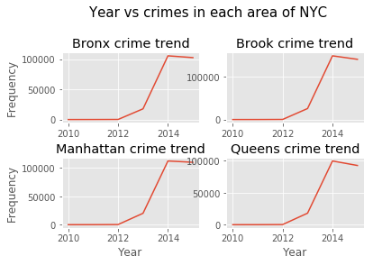
New York Crime: Trends by Area
Overall, changes in the amount of crime reported has been close to consistent across all boroughs.

Slide 15
Additional Learnings (Or: If We Knew Then What We Know Now)
LARGE DATASETS: As the datasets were very large, using loop-based Python scripts may not have been the most efficient method for cleaning this data.
DISSIMALARITY OF DATASETS FOR EACH CITY: As there was no standard format maintained for type of crimes, date etc., cleaning the data to make fair comparisons involved a lot of time consuming data-cleaning and reclassification.
DIFFICULTY WITH API CALLS: To find out areas of crime, we tried to do API calls for lat-longs we had in our dataset, but quickly learned that it would not be possible to determine locations for a meaningful subset of our data using free tools, which had relatively low daily call limits.

Slide 16
Q+A
Thank you

